Slide 1

RESUME CLASSIFICATION
Mentor Name: Mr. Adhvaith sir
Team members: (Group-5)(P-145)
Ms. Mizna Majid Patel
Mr. Pratik Tushar Gade
Mr. Aditya Mahendra Gawade
Mr. Karan Dilip Sonpure
Mr. Vivek Taral
Ms. Ishika Welekar
Mrs. Aditee Samir Dhatkar.
Mr. Akash Raju Kadam

Slide 2
Problem Statements:
Today the major problem being faced across the industry is how to acquire the right talent, using minimal resources over the internet and in minimal time. As described there are three major challenges that are required to be overcome, to bring efficiencies to the complete process.
• Separating the right candidates from the pack
• Making sense of candidate CVs
• Knowing that candidates can do the job before you hire them.

Slide 3
Business Objective
To Create a Resumes Parser based on Natural Language Processing to extract required information from resumes.
To make case of selection resumes for recruiter without actually going through each of them.
To help candidates to find and apply the most suitable job roles form the job.

Slide 4


PROJECT ARCHITECTURE
Collection of Data
Business Understanding
Exploratory Data Analysis(EDA)
Deployment
Model Building

Slide 5
Data Set Details
After Extracting and Modifying the Dataset, given data contains a total of 3 features and 79 rows . By using features we will get the desired resume sample (person) for the software organization/Company.

Slide 6
import libraries
We have to first install libraries to work on the import libraries of resume classification dataset.
#!pip install python-doc
#!python -m pip install docx2txt
#!pip install textract
#!pip install python-docx
#!pip install xgboost
#!python.exe -m pip install --upgrade pip
#!pip install docs
#!python -m spacy download en_core_web_trf
#!pip install PyPDF2
#!pip install spacy-transformers

Slide 7
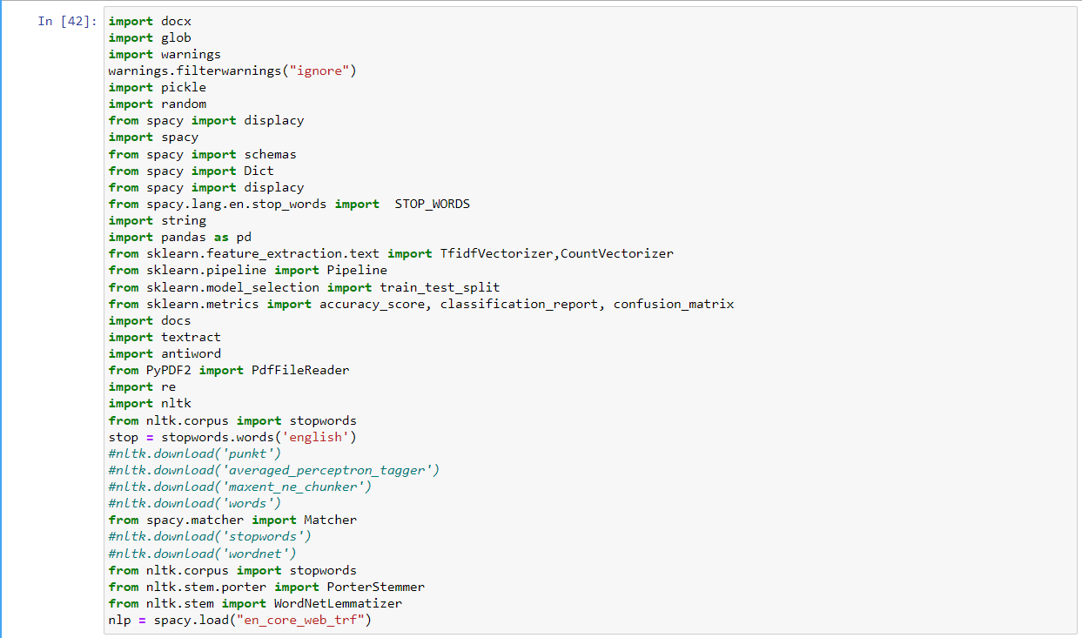
We have to import these libraries to work on the resume classification dataset.

Slide 8
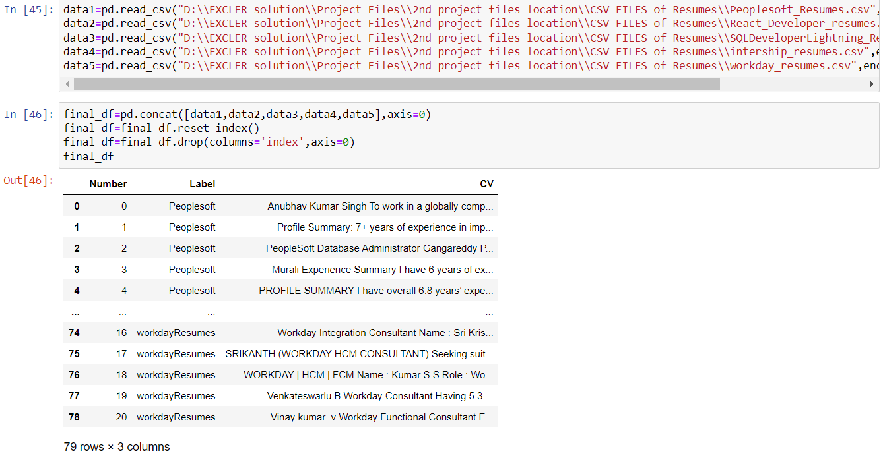
Dataset contains
The Dataset contains 79 rows and 3 columns
Features are Number, Label and CV.

Slide 9
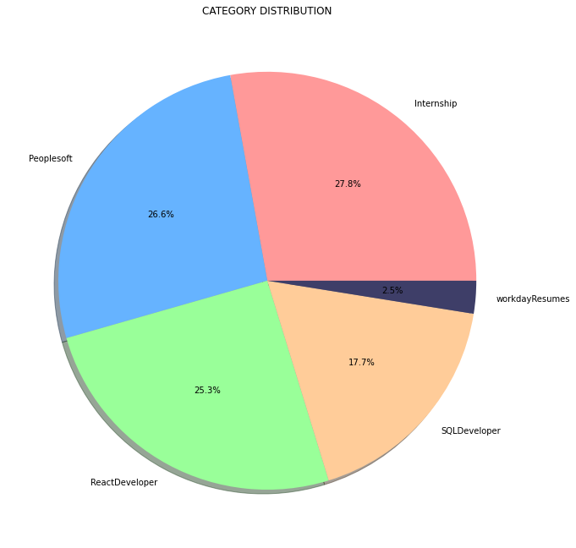
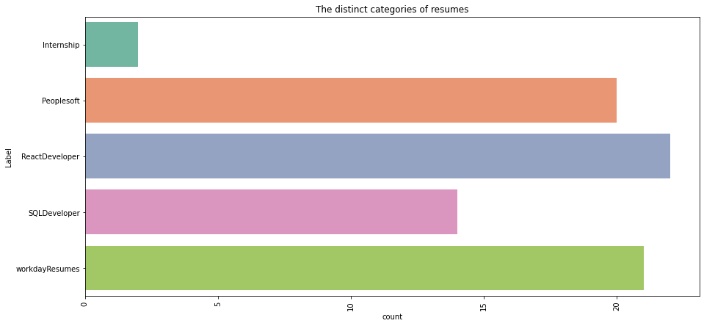
EDA Visualization
By using Pie chart role applied feature is displayed to visualize the job roles.
By using Histogram role applied feature is displayed to check the job types.

Slide 10
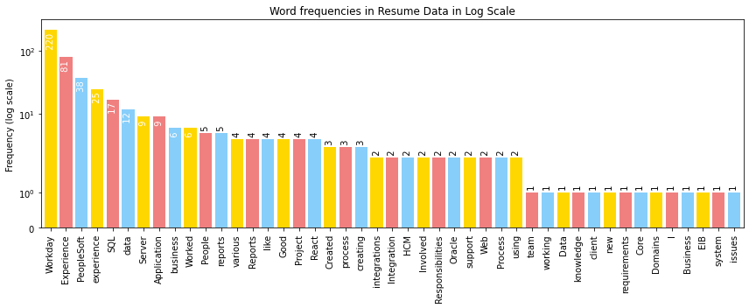
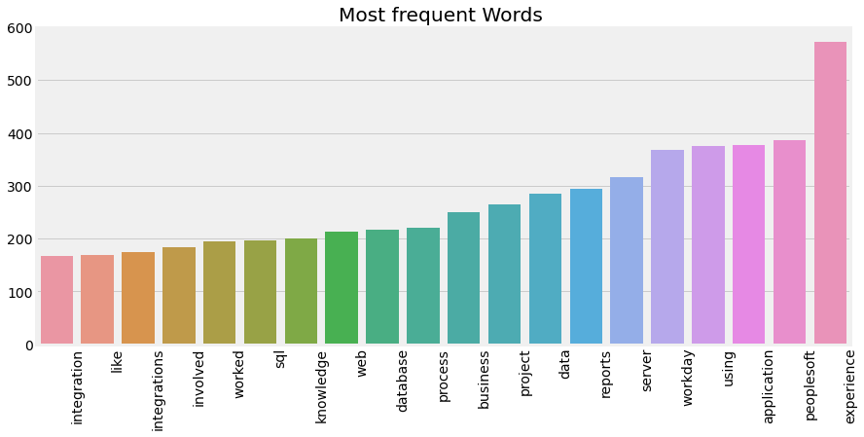
Word Frequencies in Resumes
In this graph the frequency of Words in Resumes are show, there is most of the words are highly used in the dataset like Workday, Experience, experience, peoplesoft .etc

Slide 11
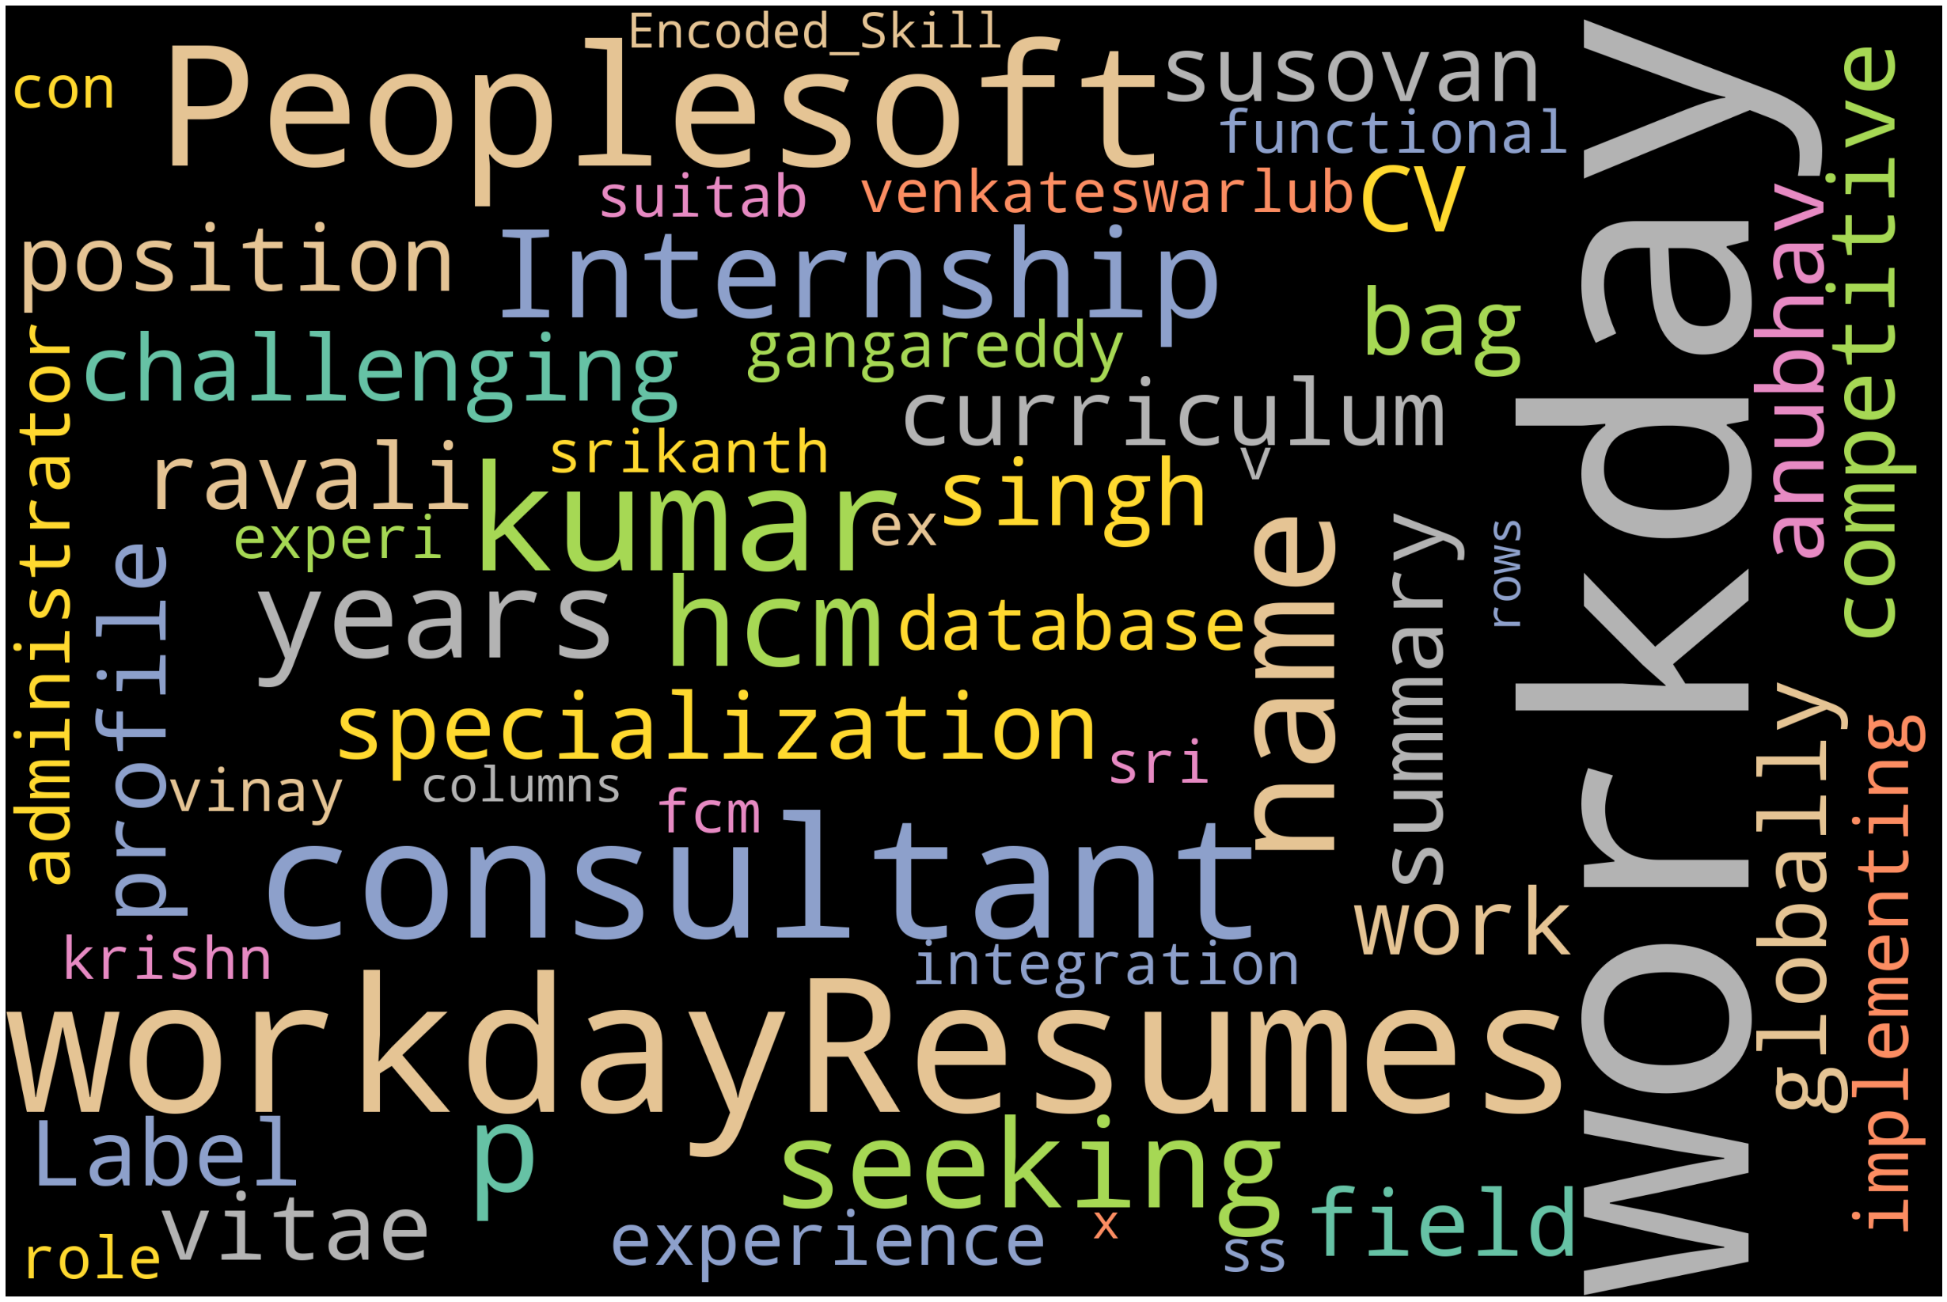
WORDCLOUD

Slide 12
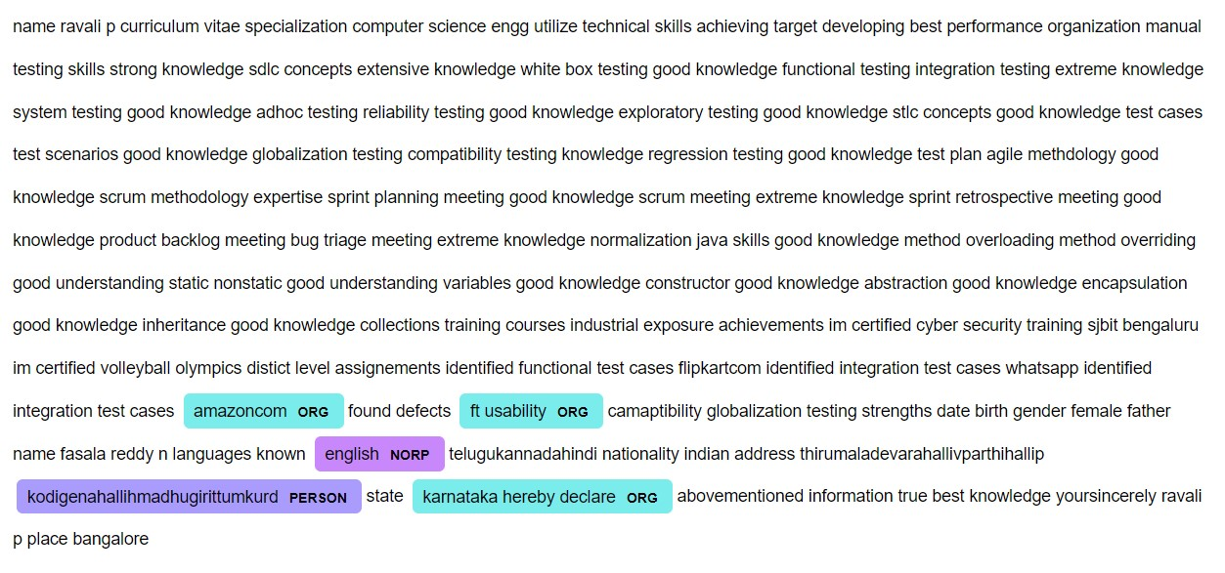
Performing A NER (Named entity recognition)(Using Spacy)

Slide 13
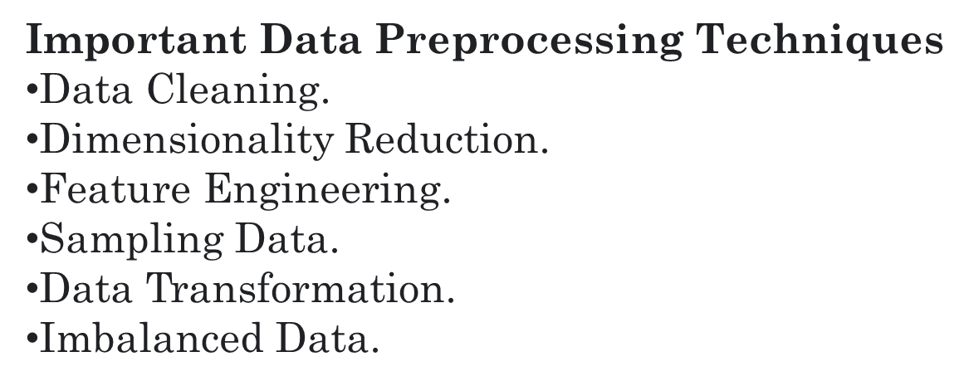
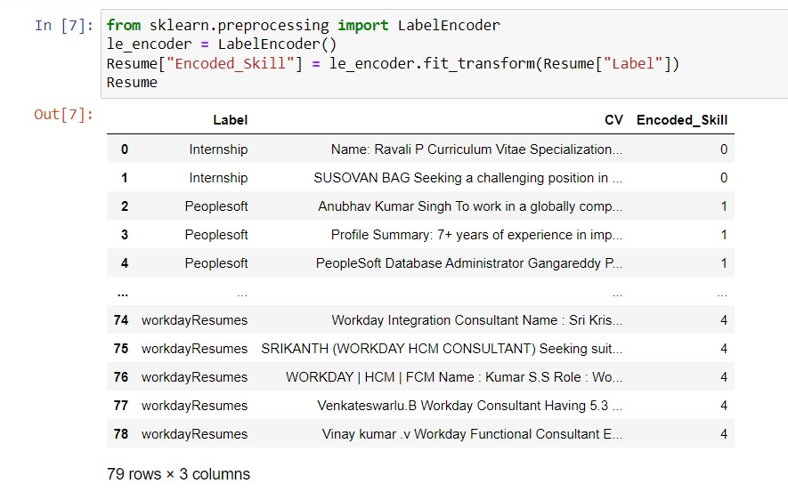
In natural language processing, text preprocessing is the practice of cleaning and preparing text data. NLTK and re are common Python libraries used to handle many text preprocessing tasks.

Slide 14
Text pre-processing:
In NLP, text preprocessing is the first step in the process of building a model. The various text preprocessing steps are: Tokenization, Lower casting, Stop words removal, Stemming, Lemmatization.
Label Encoder:
The Label Encoder is class of Sklearn library the class encoded variable digits.
The ML is between the label Encoder and one of Hot Encoder.
The encoders are scikit library in python and used to convert the data and text data.

Slide 15
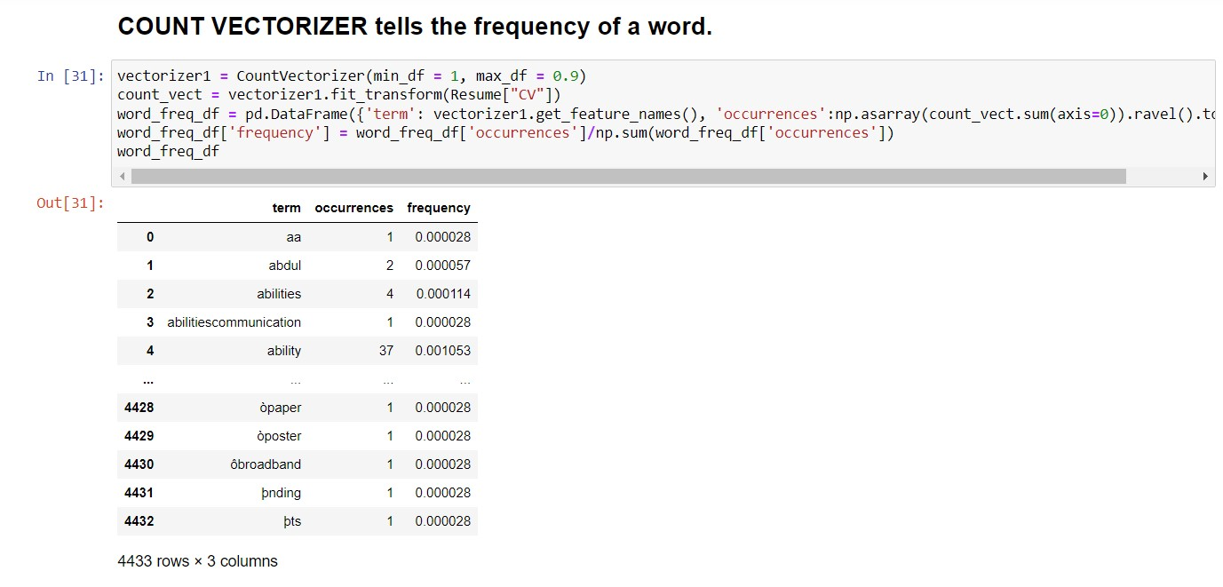
VECTORIZATION
Scikit-learn's CountVectorizer is used to convert a collection of text documents to a vector of term/token counts. It also enables the ​pre-processing of text data prior to generating the vector representation.

Slide 16
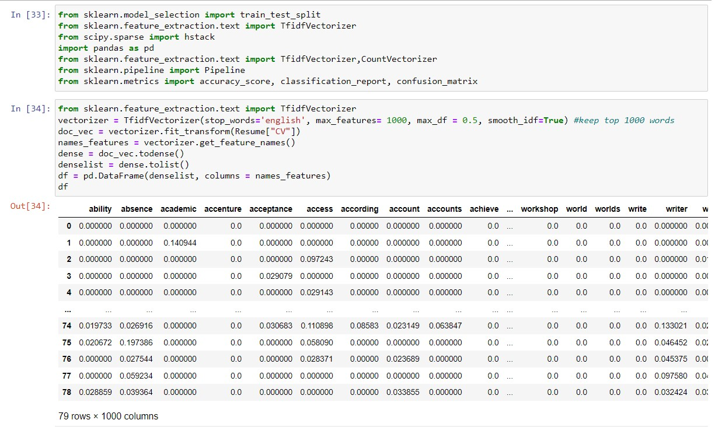
TFIDF - Term frequency inverse Document Frequency
Count Vectorizer give number of frequency with respect to index of vocabulary where as tf-idf consider overall documents of weight of words.

Slide 17
MODEL BUILDINg
DATA PREPROCESSING
We have split data into two dataset :
Train and Test. The ratio of splitting was 80 x 20.
The shape of train and test splitting:
SHAPE OF TRAIN DATA : 63
SHAPE OF TEST DATA : 16

Slide 18
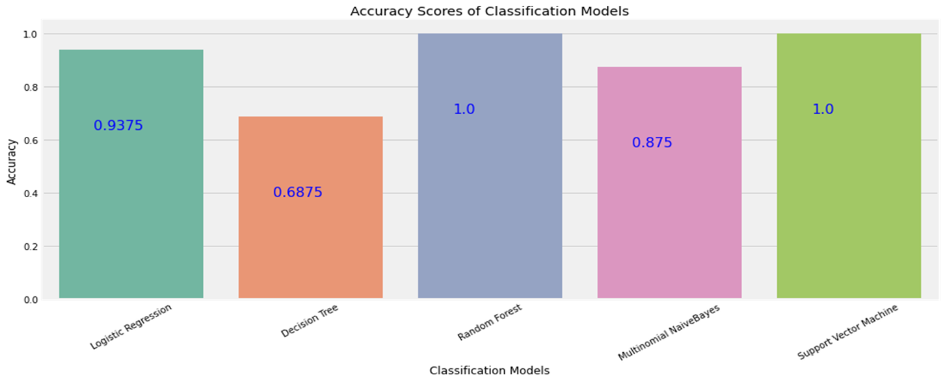
ACCURACY SCORE
We have trained and tested each model and recorded the resultant accuracy .
BELOW GRAPH SHOW THE ACCURACY OF EACH CLASSIFIER
LOGISTIC REGRESSION: 93.75%
DECISION TRESS: 68.75%
RANDOM FOREST: 100%
MULTINOMIAL NAÏVE BAYES: 87.75%
SUPPORT VECTOR MACHINE: 100%

Slide 19
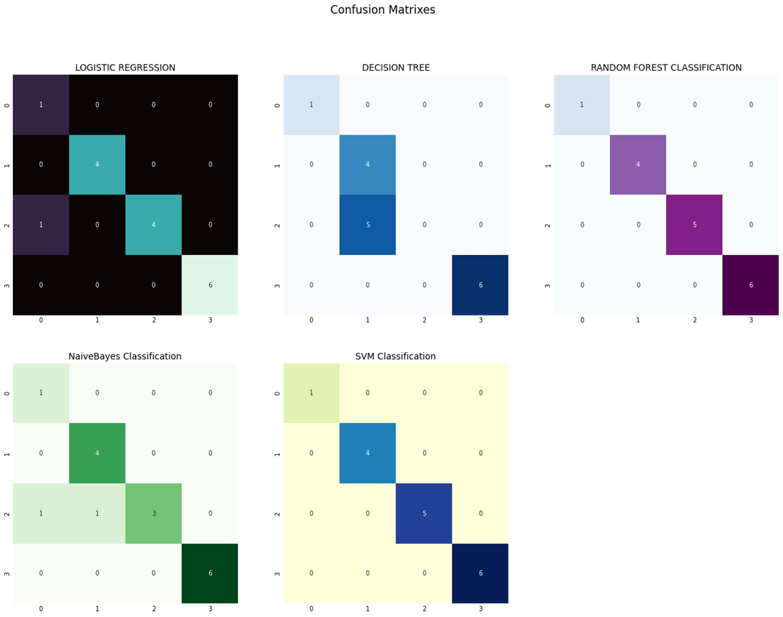
CONFUSION MATRIX
CONFUSION MATRIX visualizes and summarizes the performance of a classification algorithm. It gives information about errors made by the classifier and the types of errors that are being made . It reflects how a classification model is disorganized and confused while making predictions.

Slide 20
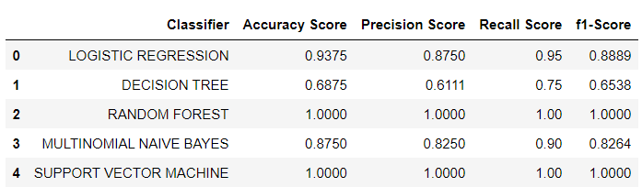
CLASSIFICATION REPORT
SHORT AND QUICK EXPLAINATION ABOUT ACCURACY, PRECISION, RECALL, F1_SCORE:
Accuracy tells us how many times the model was correct
Precision is how good the model is at predicting a specific category
Recall tells us how many times the model was able to detect a specific category
F1_score is combines the precision and recall of a classifier into a single metric by taking their harmonic mean

Slide 21
FINALIZIMG MODEL
from the accuracy , precision, recall,F1_score comparison, we got 100% result in random forest classifier and support vector classifier.

Slide 22
DEPLOYMENT
After model building and Evaluation process, We have deployed the code using Streamlit .
We have selected the best model RANDOM FOREST CLASSIFIER and used in our deployment phase

Slide 23
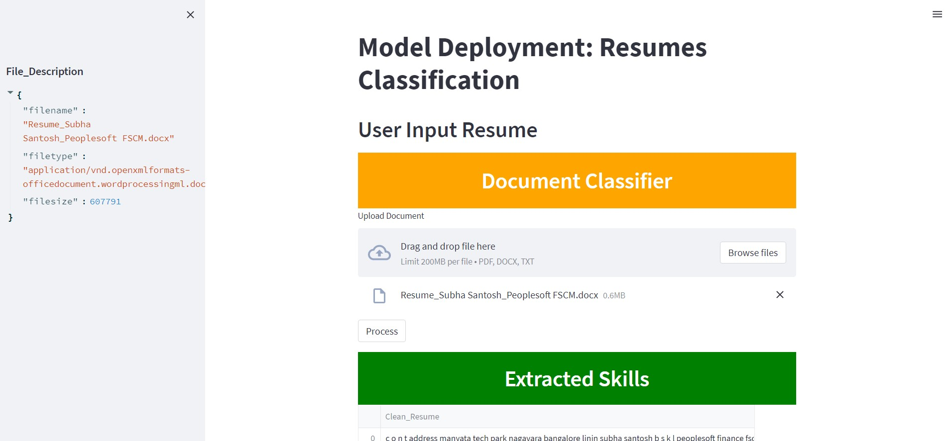
DEPLOYMENT

Slide 24
CONCLUSION
The concept of classification is grasped by Resume Classification, and classification models have been built using numerous techniques. This resume categorization platform will make the e-recruitment process more efficient and user-friendly. This approach will assist businesses and save time throughout the recruitment process.

Slide 25
THANK YOU

